Slide 1
Back Against WallStreet

Slide 2
Current Scope
Core functionality is complete on all pages
Database Functionality using CSV Files
Access to Yahoo Finance API
Watch List is accessible for recommendations
It is colorful

Slide 3
Current Schedule
Accomplishments:
Augmented recommendations
Coloring
Watchlist is now saved and usable throughout the application
Not Achieved:

Slide 4
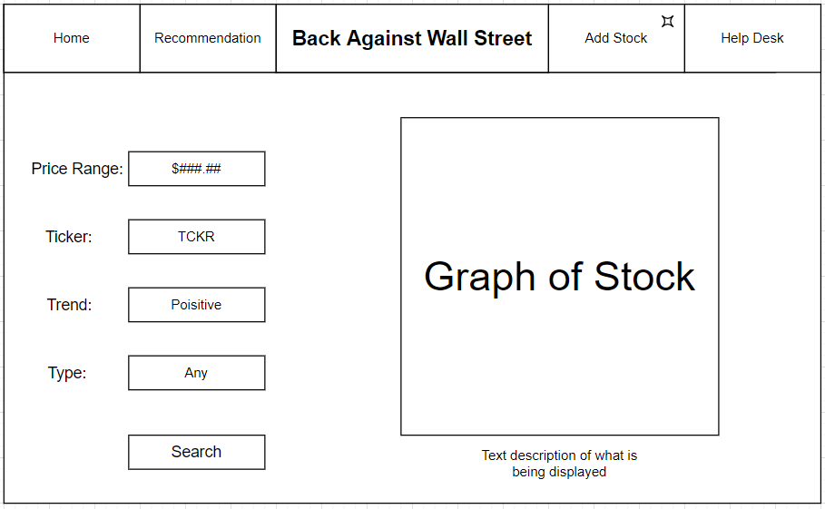
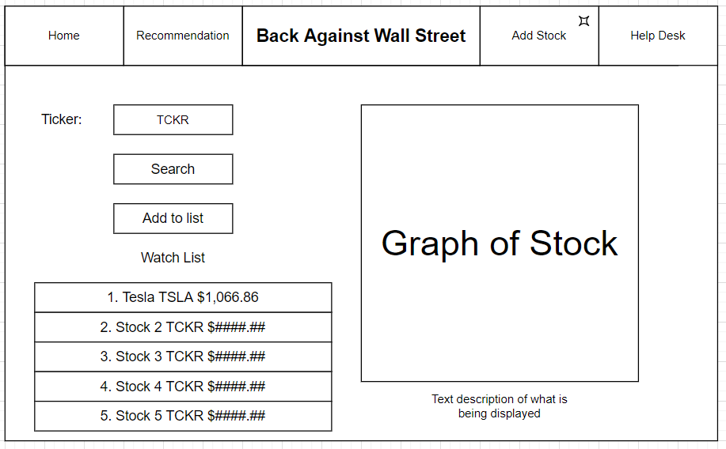
Sprint 5 Plans
WE ARE DONE!!!!!!!!!!!!!!!!!!

